Slide 1

Students performance in exams

Slide 2

Table of content
Understanding the importance of this study
How students perform in exams based on gender
ethnicity and parental education Average score
Analyse if the preparation test course effect students grades.
Analyse if type of lunch effect students grades.
Conclusion
gender Average score based on subject
Parental education level on student performance

Slide 3
Understanding the importance of this study
Purpose: to explore the relationships between student demographics, preparation levels, and their exam performance in high school education.
Size : 8 columns initially , 1000 row each row representing individual student .

Slide 4
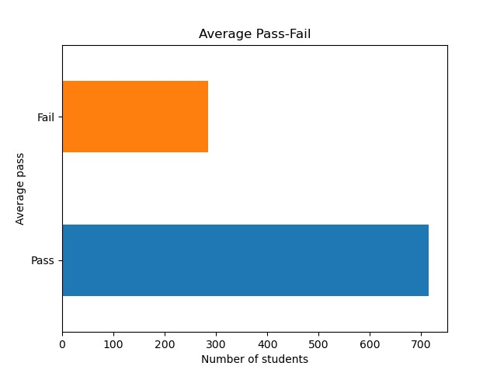
How students perform in exams?

Slide 5
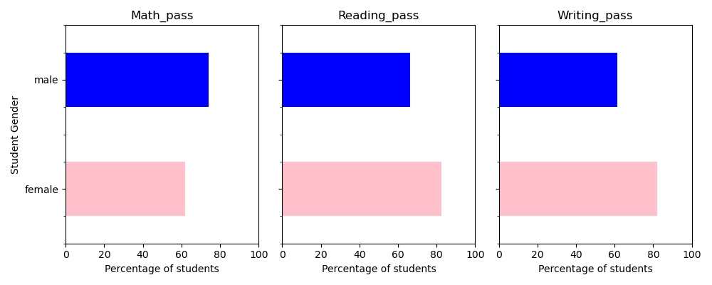
The percentage of passed students by gender based on subject

Slide 6
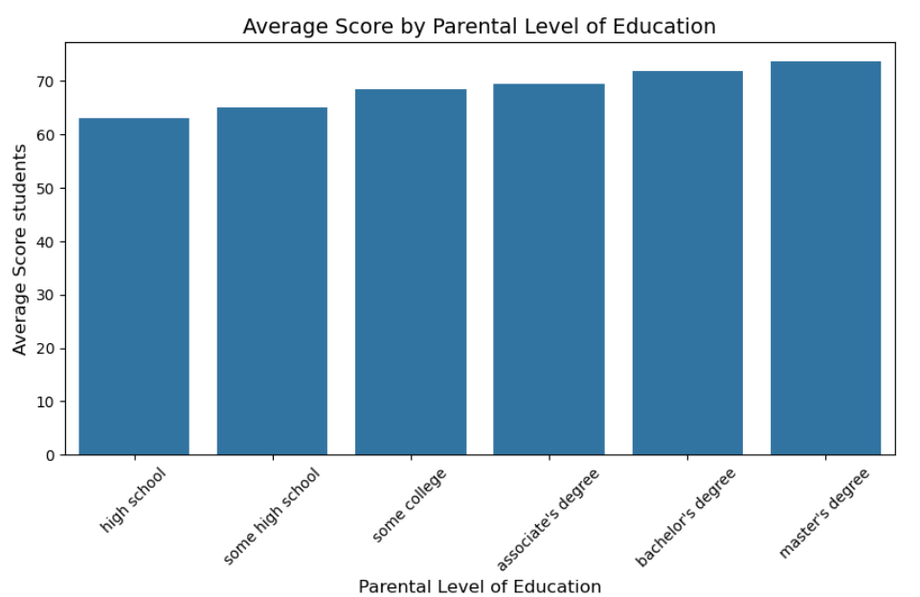
Dose parental education level effect students score ?

Slide 7
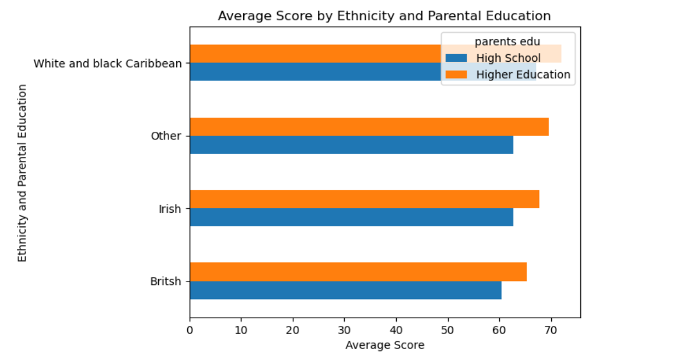
Dose ethnicity and parental education level effect students score ?

Slide 8
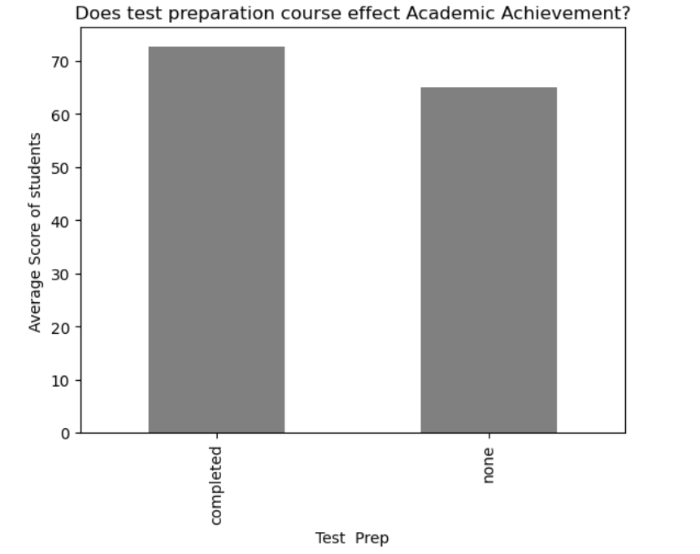
Do preparation test course effect students grades ?

Slide 9
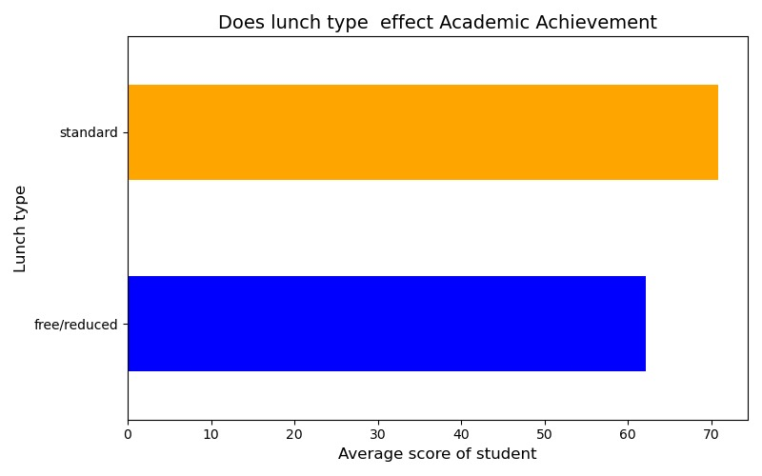
Dose type of lunch effect students grades ?

Slide 10
How can students with less scores achieve better?
Making extra math classes for female to improve their grade .
Making extra reading and writing classes for male to improve their grade.
Making extra English classes for non-native English speakers.
Improve the free/reduced lunch that the school provide .

Slide 11
Conclusion
Student performance in exams is influenced by multiple factors, including parental education, race & ethnicity, test preparation courses and lunch .
Female students outperform male students in reading and writing , while male students performed better in math.
The Parental education affect students grades which higher parents education was better for the student.
Participating in preparation test course and having stander lunch could be possible factors that affect students grades.

Slide 12

Thank you for listening

